Slide 1

THE DEFECTIVE
CHESSBOARD PROBLEM

Slide 2
DIVIDE AND CONQUER ALGORITHM
BATCH ID-J1648661666
TIYASA KUNDU-RA2011003010648
PALAK RANI-RA2011003010661
PALAK PATEL-RA2011003010666

Slide 3

ABSTRACT
The Defective Chessboard problem, also known as the Tiling Problem is an interesting problem. It is typically solved with a “divide and conquer” approach. The algorithm has a time complexity of O(n²).

Slide 4
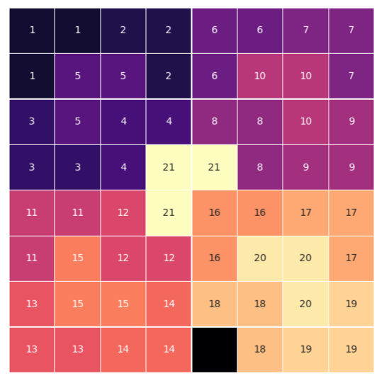
The problem:
Given a n by n board where n is of form 2^k where k >= 1 (Basically, n is a power of 2 with minimum value as 2). The board has one missing square). Fill the board using triominos. A triomino is an L-shaped tile is a 2 × 2 block with one cell of size 1×1 missing.

Slide 5
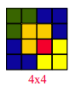
OBJECTIVES:
GIVEN CONDITIONS:-
1.We have a chessboard of size n x n, where n =2k
2. Exactly on square is defective in the chessboard.
3. The tiles(trominoes) are in L-shape i.e. 3 squares.
OBJECTIVE:
Cover all the chessboard with L-shape tiles(trominoes), except the defective square.

Slide 6
CONCLUSION
This report explains how a defective or missing square in an n x n chessboard can be found using the concept of Divide and Conquer Algorithmic Technique. It is a real time application for this approach.

